Slide 1
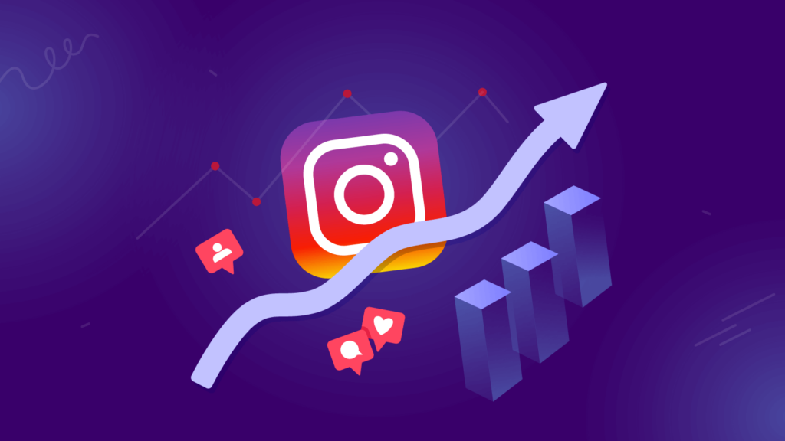
INSTAGRAM USER ANALYTICS
Presented by Rittika Roy

Slide 2

PROJECT DESCRIPTION
The project focuses on analyzing user interactions and engagement on Instagram to provide actionable insights that can drive business growth. The data analyst's role involves examining how users engage with the app, including their posting behavior, activity levels, and overall interaction with the platform. These insights are crucial for informing decisions made by the marketing, product, and development teams.
1

Slide 3


APPROACH
Here SQL queries within MySQL Workbench is used to extract, manipulate, and analyze user data. The analysis includes tracking user activity, identifying potential bots or fake accounts, determining the effectiveness of user engagement strategies, and providing insights into user behavior patterns. The findings from this analysis will help shape the future development and marketing strategies of Instagram.

Slide 4

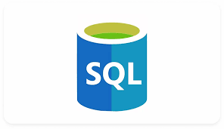

TECH-STACK USED
SQL: For writing queries to analyze user data.
MySQL Workbench: As the primary tool for managing and querying the database.
Instagram User Data: The dataset containing user interactions, posts, likes, comments, and other relevant metrics.

Slide 5
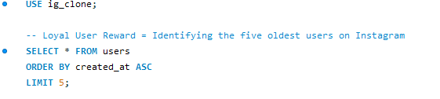
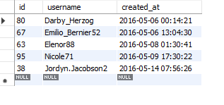

INSIGHTS
A) Marketing Analysis:
CODE:
1.Loyal User Reward : Users those who have been using the platform for the longest time.
CONCLUSION /RESULT :

Slide 6
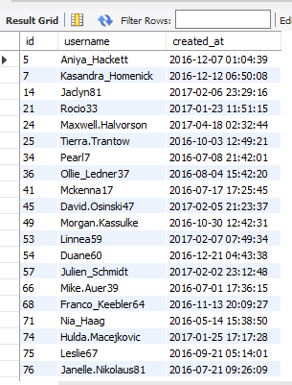
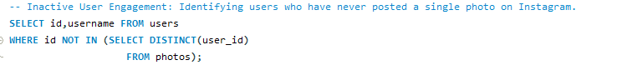
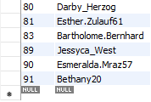
CONCLUSION /RESULT :
2. Inactive User Engagement: Identifying users who have never posted a single photo on Instagram.
This will help the team to encourage inactive users to start posting by sending them promotional emails.
CODE:

Slide 7
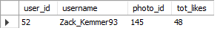
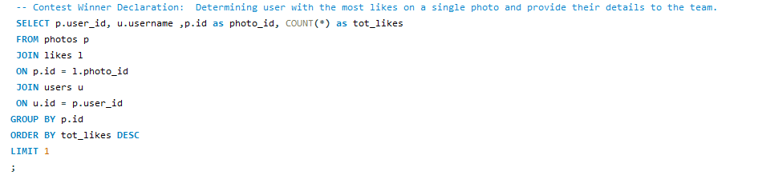
3. Contest Winner Declaration: Determining user with the most likes on a single photo and provide their details to the team.
This information will help the team to reward the user of a contest where the user with the most likes on a single photo wins.
CONCLUSION /RESULT :
CODE:

Slide 8
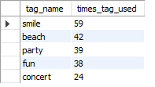
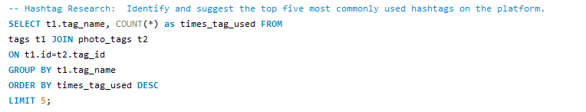
4. Hashtag Research: Identifying and suggesting the top five most commonly used hashtags on the platform.
This information will help the partner brand who wants to know the most popular hashtags to use in their posts to reach the most people.
CONCLUSION /RESULT :
CODE:

Slide 9
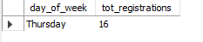
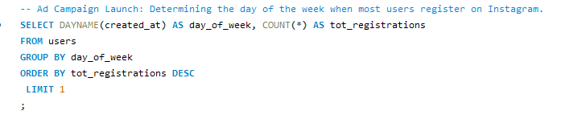
5. Ad Campaign Launch: Determining the day of the week when most users register on Instagram.
This information will help the team who wants to know the best day of the week to launch ads.
CONCLUSION /RESULT :
CODE:

Slide 10
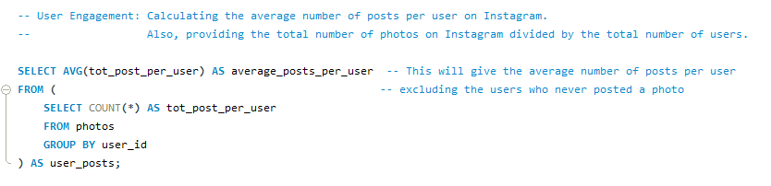
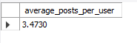
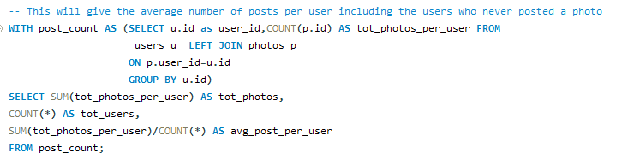
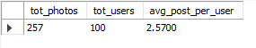
b) Investor Metrics:
1. User Engagement: Calculating the average number of posts per user on Instagram.
CODE:
CONCLUSION /RESULT :

Slide 11
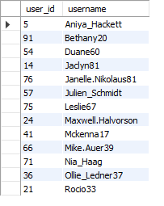
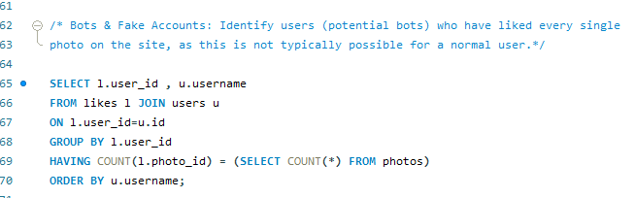
2. Bots & Fake Accounts: Identifying users (potential bots) who have liked every single photo on the site, as this is not typically possible for a normal user .
This information will help the investors who want to know if the platform is crowded with fake and dummy accounts.
CONCLUSION/RESULT:
CODE:

Slide 12

conclusion
Analysing the Instagram user dataset provided valuable insights into user behaviour, engagement patterns, and potential areas for improvement on the platform. By leveraging SQL and MySQL Workbench, the data analyst was able to identify key trends such as the activity levels of users, the presence of potential bots, and the effectiveness of user engagement strategies. These insights are instrumental in guiding the product, marketing, and development teams in making data-driven decisions that will enhance user experience, improve engagement, and contribute to the overall growth of Instagram.

Slide 13

THANK YOU!!

